Slide 1

Travel and Tourism Management System Batch 02
Under the Guidance of: - presented by:-
Mrs. P. lakshmi Juhi kumari :201FA07075
Mr. D.Madhusudhan Rao Ari Nagajajilli :201FA07060

Slide 2
Contents
Abstract
Existing System
Proposed System
Hardware and Software Requirements
Modules
Screenshots
Conclusion
Future Work

Slide 3
Abstract
Tourism Management System is a complete tourist fully integrated tourism web site. This project is developed to manage the tourist in the tourism management web site. The main module in this project are login, tourist management, complaints and reports. The objective of the project is to develop a system that automates the processes and activities of a travel and. The purpose is to design a system using which one can perform all operations related to traveling

Slide 4
introduction:
Objective of the project is to develop a system that automates the process of a travel.The Travel and Tourism Management System is a web based application and maintains a centralized repository of all related information.
The objective of this project is to develop a system that automates the processes and activities of a travel agency. In the present system a customer has to approach various agencies to find details of places and to book tickets. This often requires a lot of time and effort. A customer may not get the desired information from these offices and often the customer may be misguided.

Slide 5
Existing System
In the present system a customer has to approach various agencies to find details of places and to book tickets. This often requires a lot of time and effort. A customer may not get the desired information from these offices and often the customer may be misguided. It is tedious for a customer to plan a particular journey and have it executed properly.

Slide 6
Proposed System
The proposed system is a web based application and maintains a centralized repository of all related information. The system allows one to easily access the relevant information and make necessary travel arrangements. Users can decide about places they want to visit and make bookings online for travel and accommodation.

Slide 7
Software Requirements
Web Server : Apache Tomcat 5.5
Database : MySQL 5.0
Technology : JAVA/J2EE
Server Side Scripting : JSP
Client Side Scripting : JavaScript
Interface Designing : HTML, CSS

Slide 8
Hardware Requirements
Pentium IV processor architecture
➢ 512 MB RAM or above.
➢ 40 GB Hard Disk Space or above.

Slide 9
MODULES
Administration Module
Travels module
Routes module
Reservations module
Testimonials module

Slide 10
Admin Module
This module provides administrator related functionality. Administrator manages all information and has access rights to add, delete, edit and view the data related to places, travels, routes, bookings, etc.Information about the travel agencies and bus routes.Addition and Cancellation of travel agencies.Addition and Cancellation of bus routes.Adding and deleting Pickup points for each bus route

Slide 11
Travel Module :
This module provides the details of various travel agencies. A user can select the appropriate agency depending on convenience and accessibility.
Route Module:
This module proves information related to various routes connecting sources and destinations. For each route, information such as source, destination, fare, reservation details, pick up points etc are provides. Only administrator can add, delete, edit and manage the data. Users can only view the information

Slide 12
Testimonials module
Users of this application can post their opinions, complaints and suggestions regarding this portal and services to the administrator. Accordingly, the administrator can take various steps to act on the complaints and suggestions

Slide 13
Reservations module:
This module provides functionalities that allow a user to book tickets or cancel previously booked tickets. The module maintains the details of all reservations made so far and allows administrator to either confirm or reject the bookings.

Slide 14
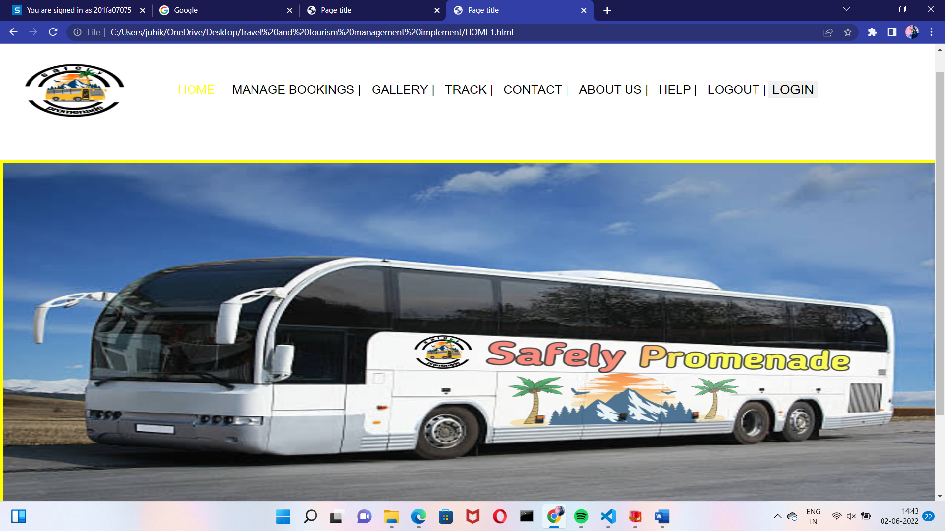
Screenshots

Slide 15
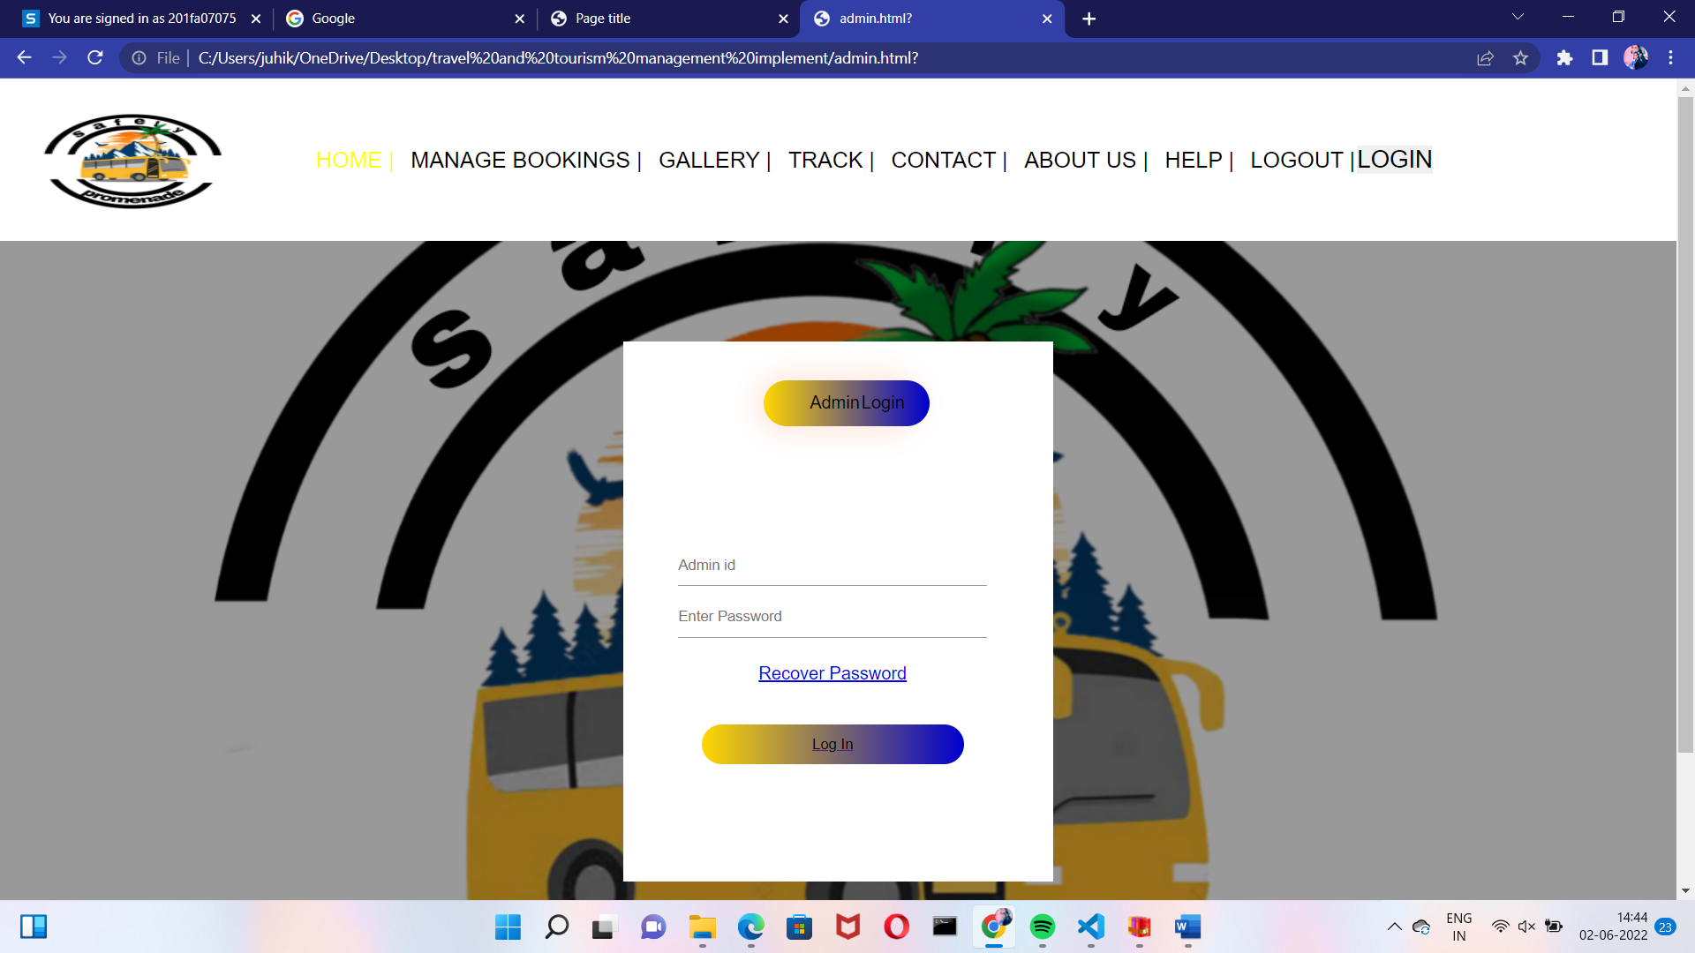
Screenshots

Slide 16
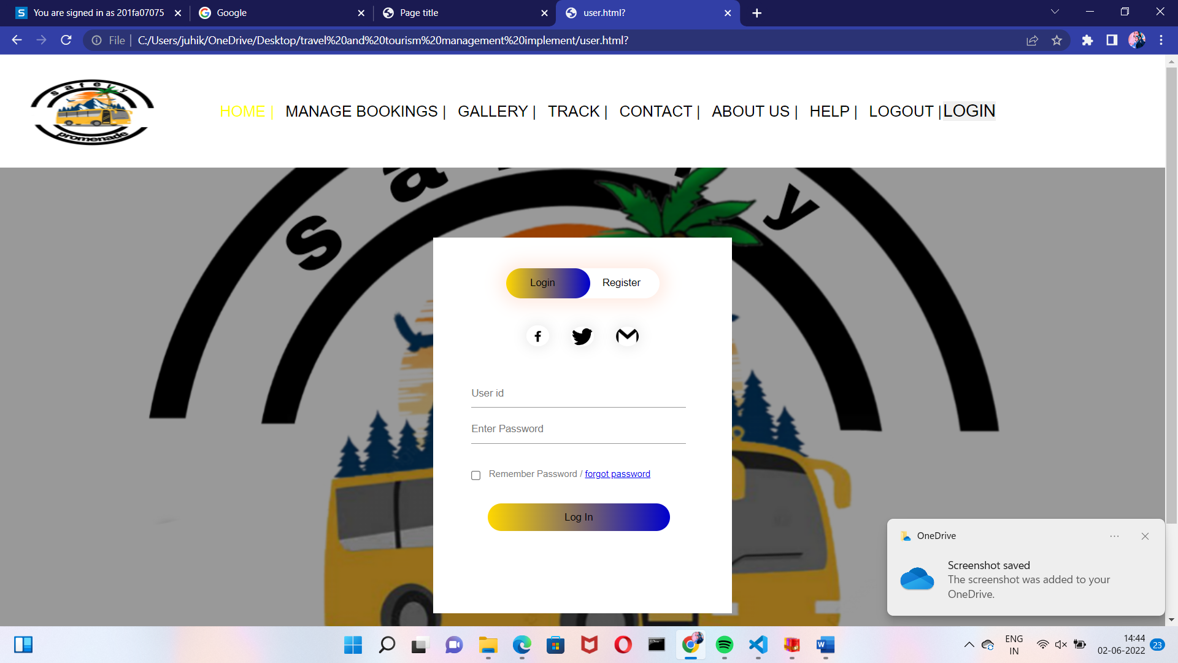
Screenshots

Slide 17
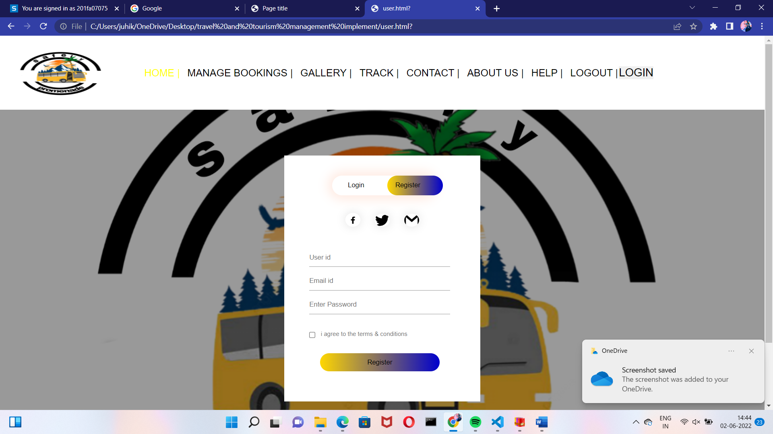
Screenshots

Slide 18
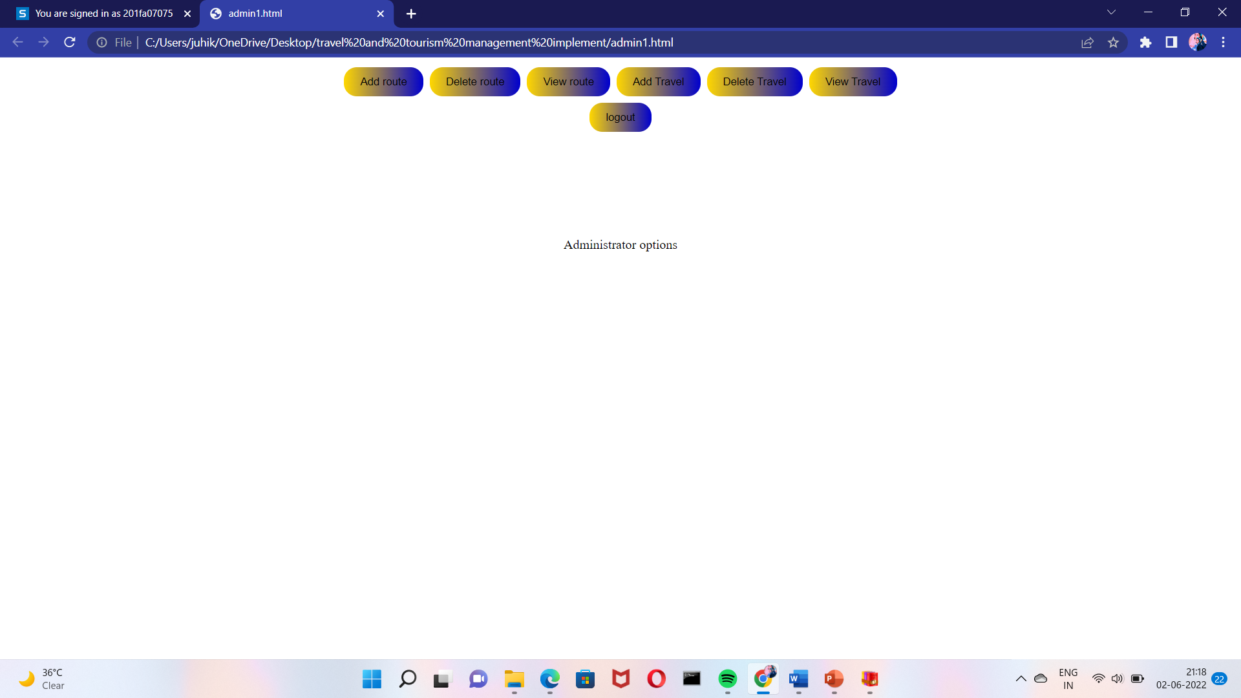
Screenshots

Slide 19
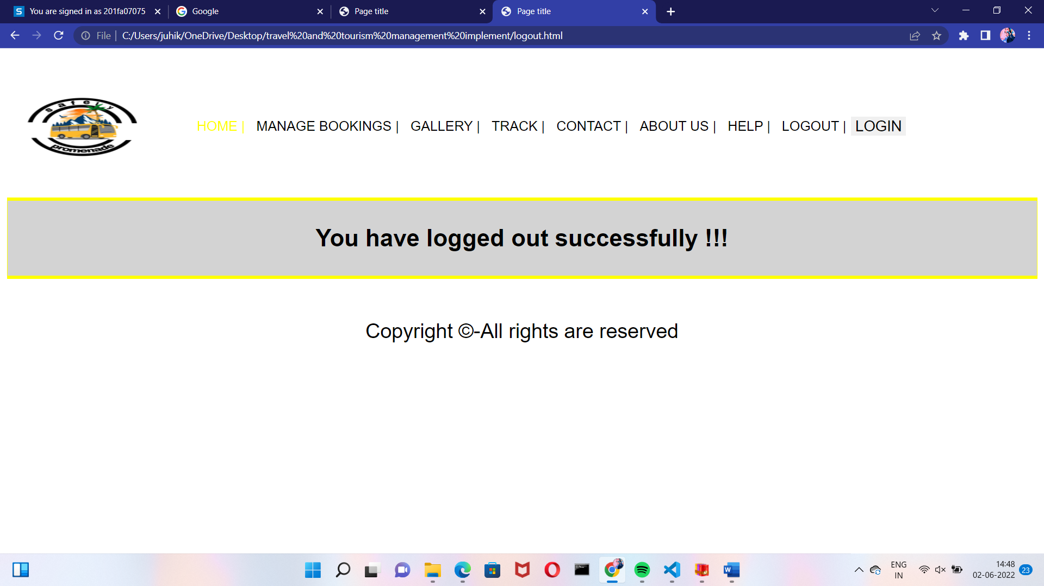
Screenshots

Slide 20
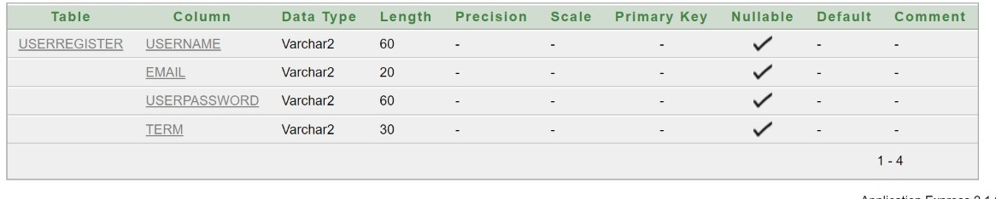
BACK END TABLES:

Slide 21
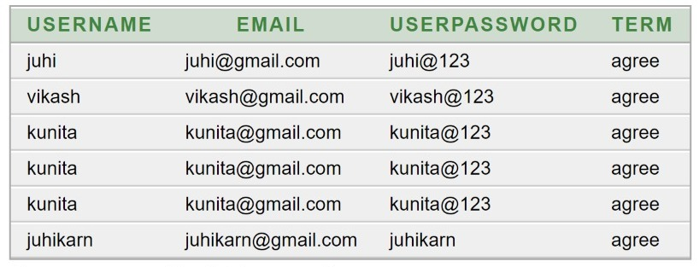
BACK END TABELS:

Slide 22
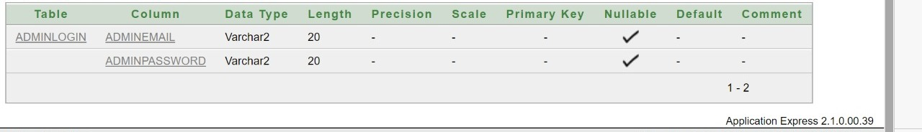
BACK END TABLES:

Slide 23
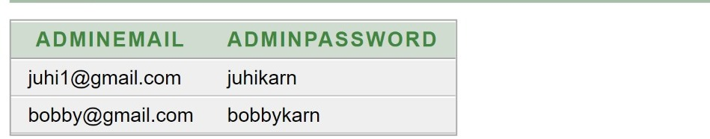
BACK END TABLES:

Slide 24
Conclusion
“Travel and Tourism Management System” management process in travelling Fast processing and immediate results with high security Minimizing human effort and cost efficient database Navigation through the site is very easy. The web site covers all the areas required for an including tourism.

Slide 25
Future Work
According to Ari Steinburg, the founder of a travel startup Vamo, the tourists will tend to spend less time planning in advance. Efficient booking services and apps will enable the tourists to create versatile itineraries with reasonable price
Future tourists would not prefer to be confined to packaged tours. With the availability of large number of options, the tourists would prefer to realize every possible wish regarding tourism. With more flight connectivity, travelling modes and accommodations introducing more comfort, technology helping mankind progressively, the tourism will continue to bring momentum in its sector.

